Slide 1
CMIL-project meeting
11th Feb 2025

Slide 2
Items to discuss
Project Status Update
Patching algorithm
Tissue patterns for CMIL classification
UDI (Ugly duck index) for CMIL classification
Patching questions
Patch shape / size / number

Slide 3
Status update
Project status is on the project website:
We matched tissue slices based on the shape of the epithelium across the three stains – H&E, melan-A, and sox-10, for all the 107 cases
The folder with the slices has been shared with you (26th Jan 2025), with case numbers as mentioned in the shared spreadsheet.
The matching status of each slice can be seen here
Questions:
Should we prioritize the 84 slices that have matches for annotation?
Which and how many slices should be annotated and provided to us for model training, and the rest used as test data?
There are some Liverpool cases highlighted in yellow. Is there anything different about them?

Slide 4
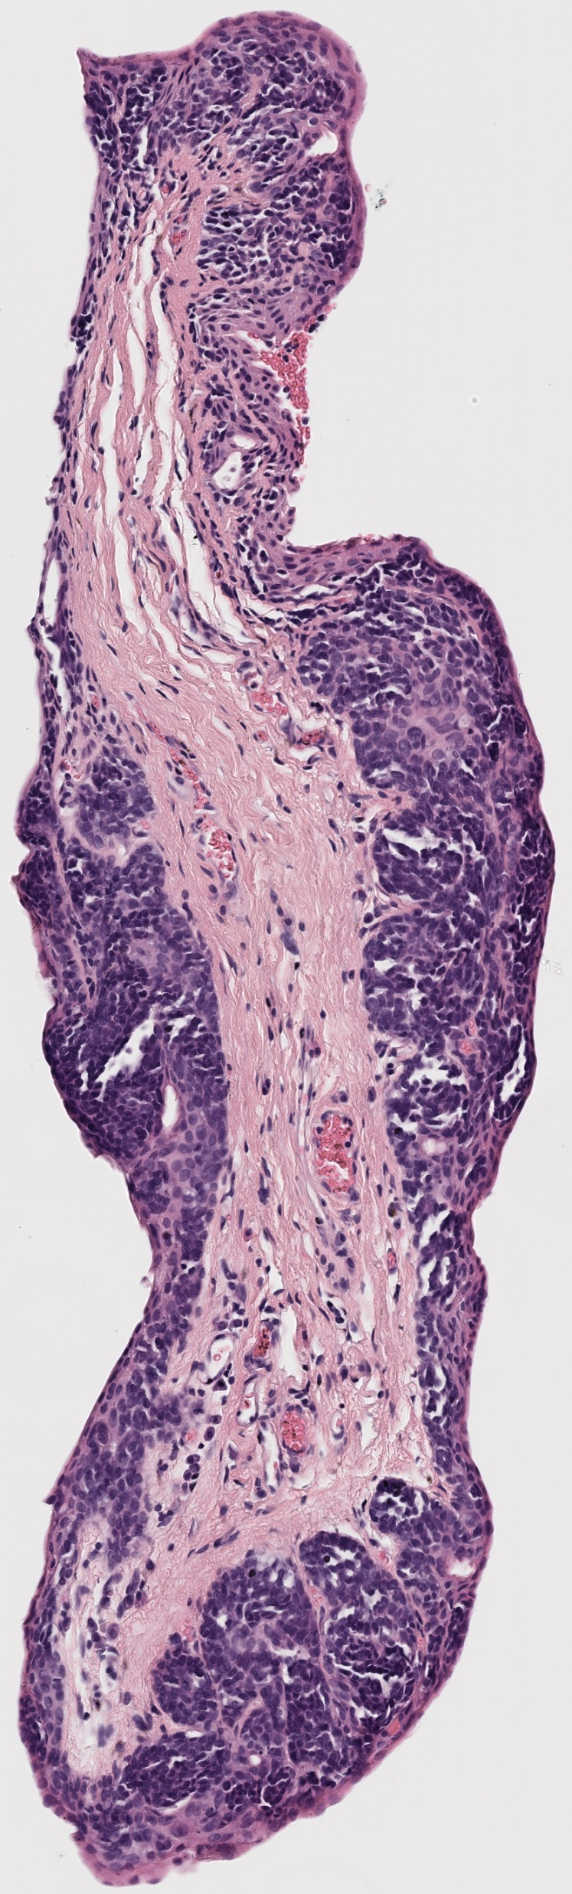

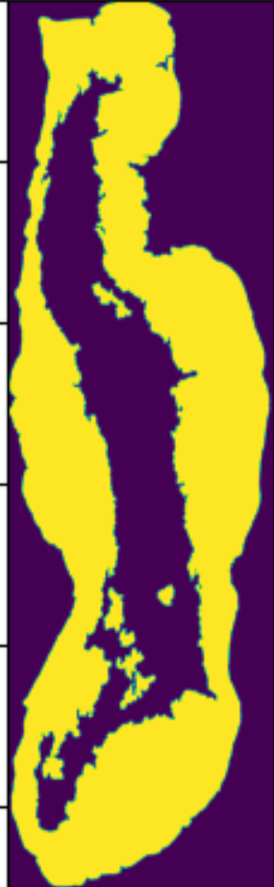
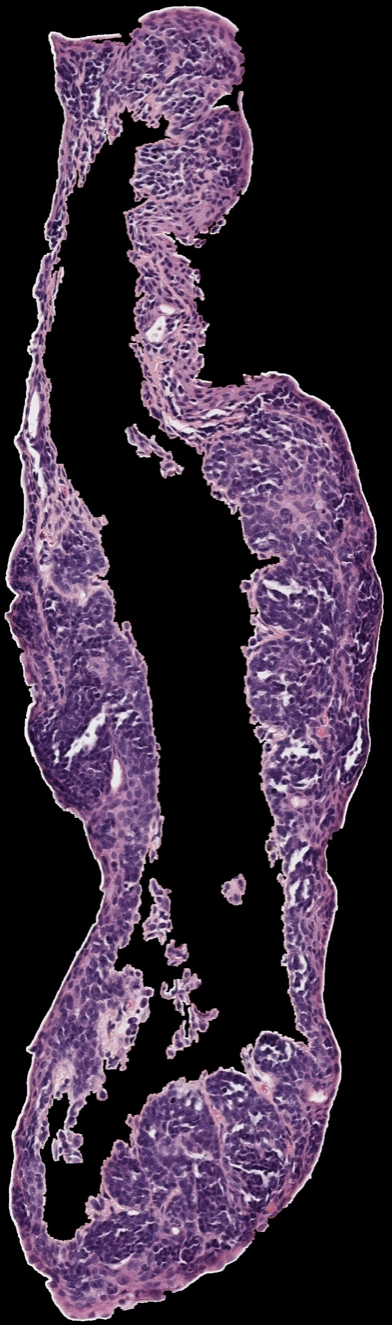
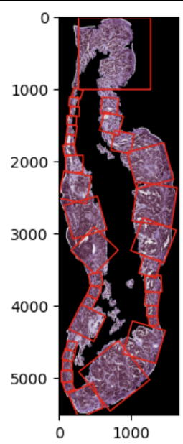






Patching algorithm: update
Tissue slice
Largest contour
Tangent along the contour
Get the width perpendicular to the tangent
Make the patch
Keep making patches around the contour

Slide 5
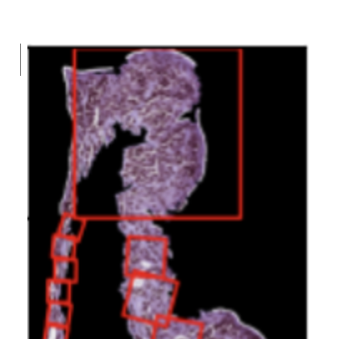
Patching algorithm: update
Currently, we are updating the algorithm to:
Make patches on the epithelium within the stroma
Fix inappropriate patch size in some cases

Slide 6
Tissue patterns for CMIL classification

Slide 7
Categories Based on the papers
Benign
Conjunctival Nevus
PAM without atypia
Precursor to Melanoma
PAM with atypia (low-risk)
PAM with atypia (high-risk)
Melanoma (malignant)

Slide 8
Patterns mentioned in the paper
1. Maturation (do the cells change as they go deeper?)
Benign nevi: the cells get smaller and more organized as they move deeper
Melanoma: the cells stay large and disorganized all the way down (no maturation)
2. Atypia (do the cells look abnormal?)
Benign nevi: The cells are round, small and uniform
High-risk lesions and melanoma: the cells are large, oddly shaped, and have dark, messy-looking nuclei
3. Pagetoid spread (are the cells spreading upwards?) - we already use this so can be disregarded
Seen in melanoma and high-risk PAM: Some abnormal cells climb up into the upper layers of the epithelium
Not seen in benign nevi: cells stay neatly at the bottom layer
4. Cysts
Benign nevi often have cysts
PAM and melanoma do not - these lesions are solid

Slide 9
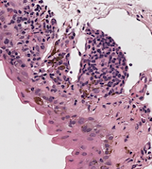
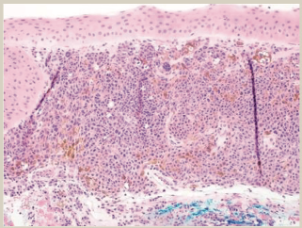
Maturation - Reference Paper (left) & Our Data (right)
do the cells change as they go deeper, benign case?
Cells become smaller and less cytoplasmic as they descend to the substantia propria
Figure 9 Subepithelial melanocytic nevus of the conjunctiva is composed of melanocytes only within the substantia propria. Maturation can be seen, whereby lesional cells become smaller in size with descent into the substantia propria (H&E, 200).
Case 39

Slide 10
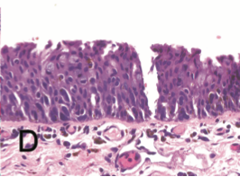
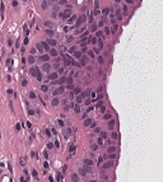
Atypia
Cells have varied shapes and sizes, low / high grade CMIL?
Nuclear crowding and overlap significant, cells are pleomorphic (varied shapes and sizes)
D, Primary acquired melanosis with atypia (high-risk pattern). Large cells with epithelioid features and abundant cytoplasm indicate a high probability of concurrent or subsequent invasive melanoma (hematoxylin-eosin, original magnifications 3400 [A and B], 3100 [C], and 3200 [D]).
Case 57

Slide 11
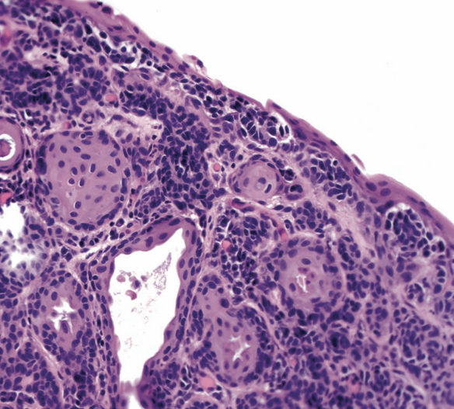
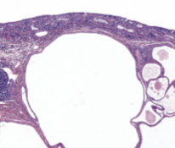
Cyst Formation Examples - Reference Paper
Benign
Notes:
Benign tissue may develop cysts, like the one pictured here.
Tissues without cysts may be benign or malignant, so the absence of cysts may not be as helpful for diagnosis.

Slide 12
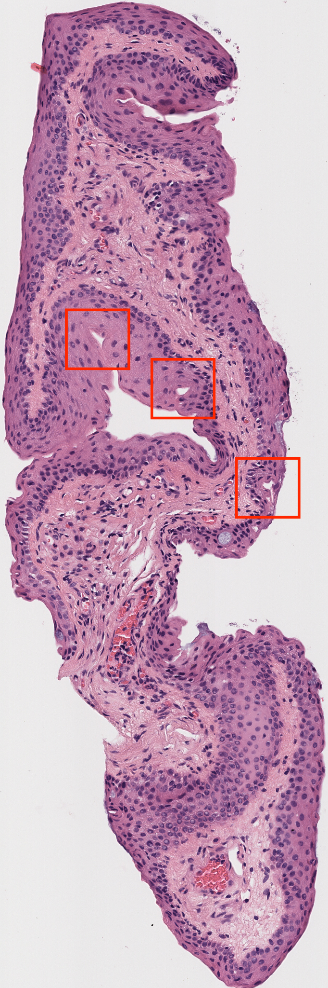

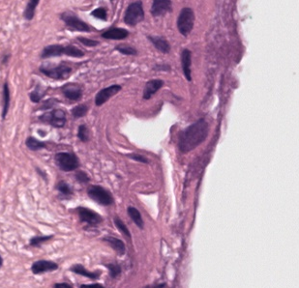
Cyst Formation Examples - Our Data
Benign - Case 002

Slide 13
Papers used as reference
Zembowicz A, Mandal RV, Choopong P. Melanocytic lesions of the conjunctiva. Arch Pathol Lab Med. 2010 Dec;134(12):1785-92. doi: 10.5858/2009-0522-RAR.1. PMID: 21128776.
Carli P. Whittington, Scott C. Bresler, Caroline Simon, Carol L. Shields, Rajiv M. Patel, Melanocytic lesions of the conjunctiva: an up-to-date review, Diagnostic Histopathology, Volume 30, Issue 1, 2024, Pages 37-59, ISSN 1756-2317, https://doi.org/10.1016/j.mpdhp.2023.10.005. (https://www.sciencedirect.com/science/article/pii/S1756231723001652)

Slide 14
Ugly Duck Index for CMIL classification

Slide 15
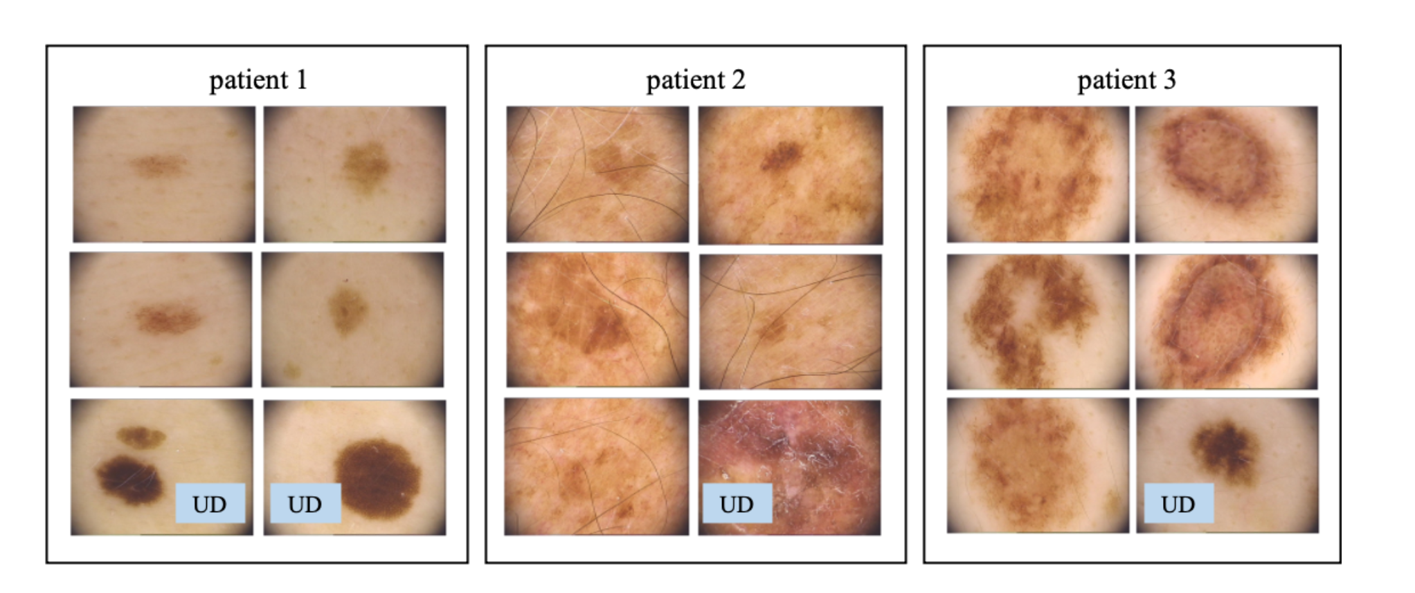
Ugly Duck Index used to detect melanoma in skin lesions
The ugly duckling sign was developed based on the fact that naevi on an individual tend to resemble one another, whereas malignant melanoma often deviates from this nevus pattern and stands out from its peers on a common body region.
Hence, an ‘Ugly Duckling’ lesion is defined as a visually different outlier from its surrounding naevi on an individual, and is considered suspicious for malignancy.

Slide 16
Questions on patching
Medical aspect questions
Why would the ML model needs a patch that includes the entire width of the epithelium, as the ML model may learn patterns to classify the patch without being informed of the location of the melanocytes? Was the entire width necessary for the doctors, but may not be necessary for the ML model?
Brown vs purple melanocytes in paper – what is the difference?
ML questions
If two opposite corners of the patch are outside the epithelium, will it be an acceptable patch? This will lead to width of the epithelium being along the diagonal of the patch - will our model be able to identify that?

Slide 17
Dependency on the “experts”
How does dependency on experts effect the model accuracy?
There is human error in labelling
Experts may not label all the cases the same way if they label again!
Ground truth is typical not 100% accurate as it contains human errors
However, a ML can will be robust to human errors as long as the human errors are small (~10% mislabelled data)
Thus may be more accurate than humans as long as it captures all the patterns that humans capture

Slide 18
Shape and size of patches
We will be using square patches because:
All the features, such that melanocyte shape, distribution, etc. can be captured via square patches
Square patches are more popular in literature, which may provide us several existing CNN model architectures
We will prefer using patch size in powers of 2, such as 128 x 128, 256 x 256, etc. because:
It provides more flexibility in adaptive pooling, i.e., downsampling the image, depending on the size
It is computationally more efficient for parallel processing (we’ll check this)

Slide 19
Number of patches
Number of patches will depend on the patch size
First, we’ll get patches that:
Cover the width of the epithelium
Have minimum overlap with each other
Have maximum overall coverage of the epithelium
Have minimum background in them
Then, we’ll observe the distribution of the patch size of the above patches (histogram)
We will choose patch sizes as per the modality of the histogram

Slide 20
Classification model
We already have labelled data at case-level for the 106 cases!
Human classification accuracy of benign vs high-grade CMIL:
Agreement for benign CMIL: 74.5%
Agreement for high-grade CMIL: 85.3%
We can start with making a classification model than does better than humans!

Slide 21
Patching algorithm: publication

